Slide 1
CSE 10124 Embeddings 02

Slide 2
Logistics: Exam 01

Slide 3
Predicting the Next Token: Markov
Prompt: “I like cute and fuzzy”
<|sos|>
I
like
cute
dogs
and
fuzzy
cats
blankets

Slide 4
Predicting the Next Token: Markov
Prompt: “I like cute and fuzzy”
<|sos|>
I
like
cute
dogs
and
fuzzy
cats
blankets

Slide 5
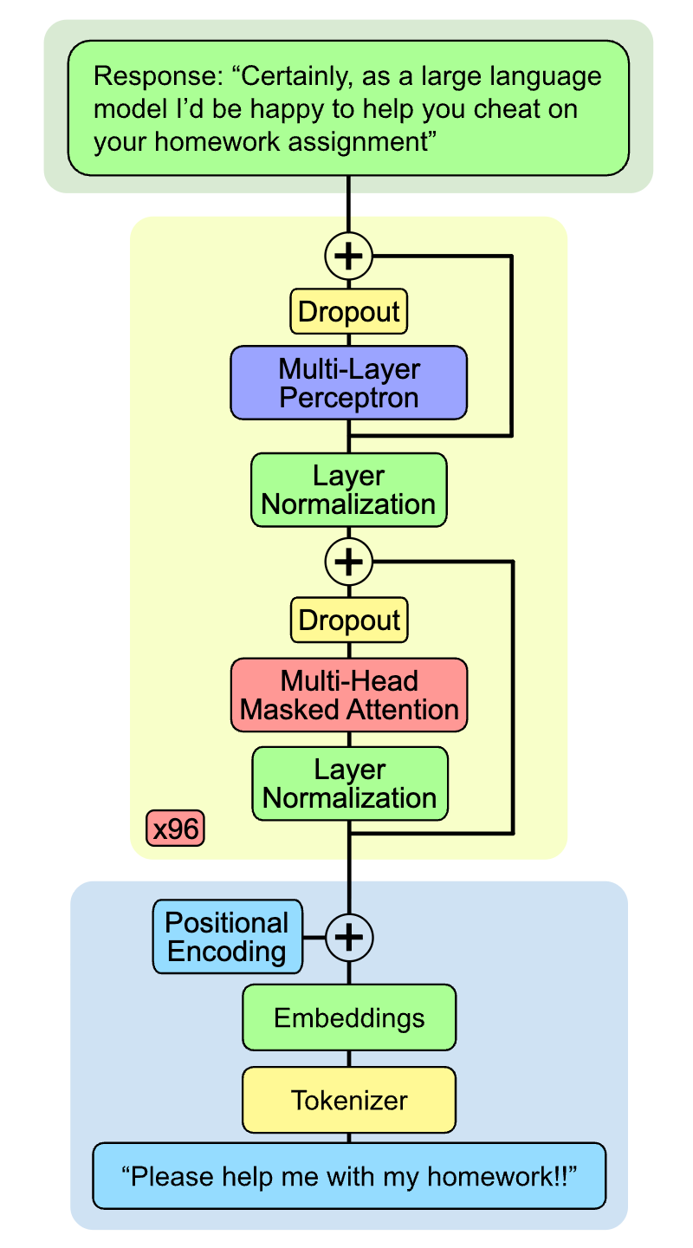
Where are we?
Today we’re going to continue on the step that follows tokenization, which is called embedding.
Understanding the concept of embedding is crucial to understanding deep learning in general.

Slide 6
Embeddings
An embedding is just a vector of small numbers that represent our words:
Prompt: “dirty”
Token: 119594
Embedding:
tensor([[-0.0685, -0.2527, 0.0342, ..., -0.0179, -0.0024, 0.0214]])
When we type a prompt into a model we first convert it to tokens and then embeddings

Slide 7
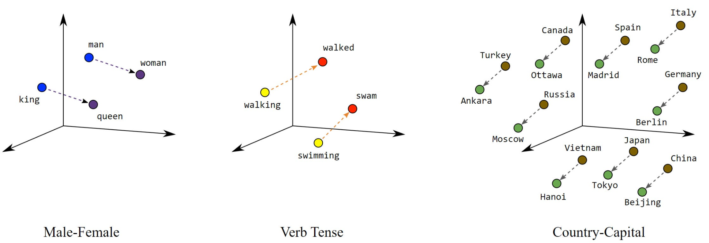
Space - Embeddings
Converting tokens to embeddings allows us to interpret them as points in high dimensional space, which then allows us to compare them against each other!

Slide 8
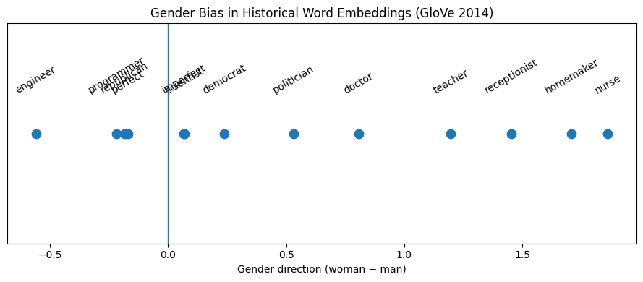
Embeddings
This allows us to find words that are related to each other. Remember that related is only based on co-occurrences!!

Slide 9
Predicting the Next Token: SLM
Prompt: “I like cute and fuzzy”
<|sos|>
I
like
cute
and
fuzzy
output
vector

Slide 10
Learning Embeddings
Predicted Output:
<0.1, 0.2, …, 0.01>
Prompt:
“Hello there”
Compare
Tokens:
{“hello”: 73, “there”: 44}
Magic Box
SLM
Expected Output:
<0.0, 0.0, …, 1.0>
Embeddings:
{73: <0.4, 0.3, …, -0.02>
44: <0.27, 0.8, …, 0.06>}
Ground Truth:
“Hello there General”

Slide 11
Learning Embeddings
Predicted Output:
<0.1, 0.2, …, 0.01>
The outputs are just a vector the size of our vocab, and the number can be interpreted as the probability of that token being next
Compare
Expected Output:
<0.0, 0.0, …, 1.0>
Ground Truth:
“Hello there General”

Slide 12
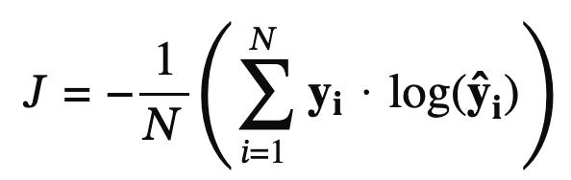
Deep Learning: Loss Functions
A loss function allows us to numerically measure how far off our model’s predicted values are from what we expected them to be, or what we know the right answer is.
Cross-Entropy: The loss function used to train LLMs is called “Cross-Entropy Loss” and it’s one of the most common loss functions. Heavily based on the principle of “entropy” as used in Information Theory, it’s a measure of how surprising our answer is relative to our ground-truth based on the entropy formula: -∑ p(x)log₂p(x)
Mostly outside the scope of the class, but it’s really not that complicated.

Slide 13
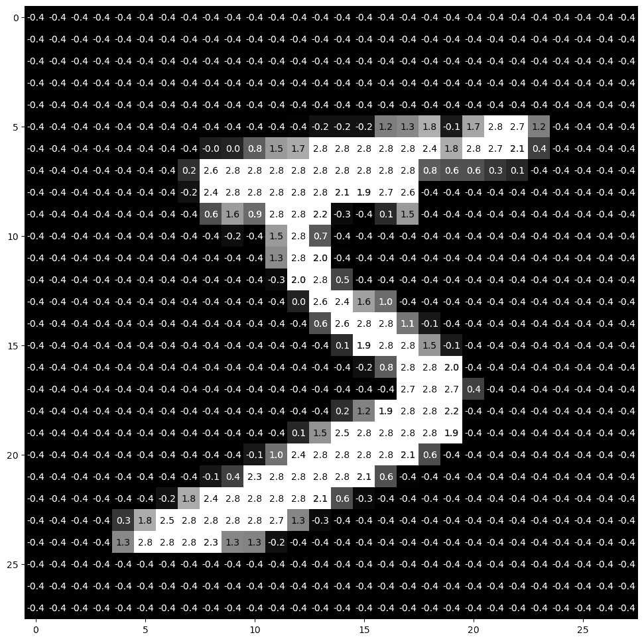
Embedding Learning Visualization

Slide 14
SLM vs. LLM
All we do to convert our SLM to an LLM is replace our Magic Box with a fancier one, the overall process of training our model doesn’t change!

Slide 15
Predicting the Next Token: LLM
Prompt: “The river has a nice bank and”
The
river
has
a
nice
bank

